Slide 1

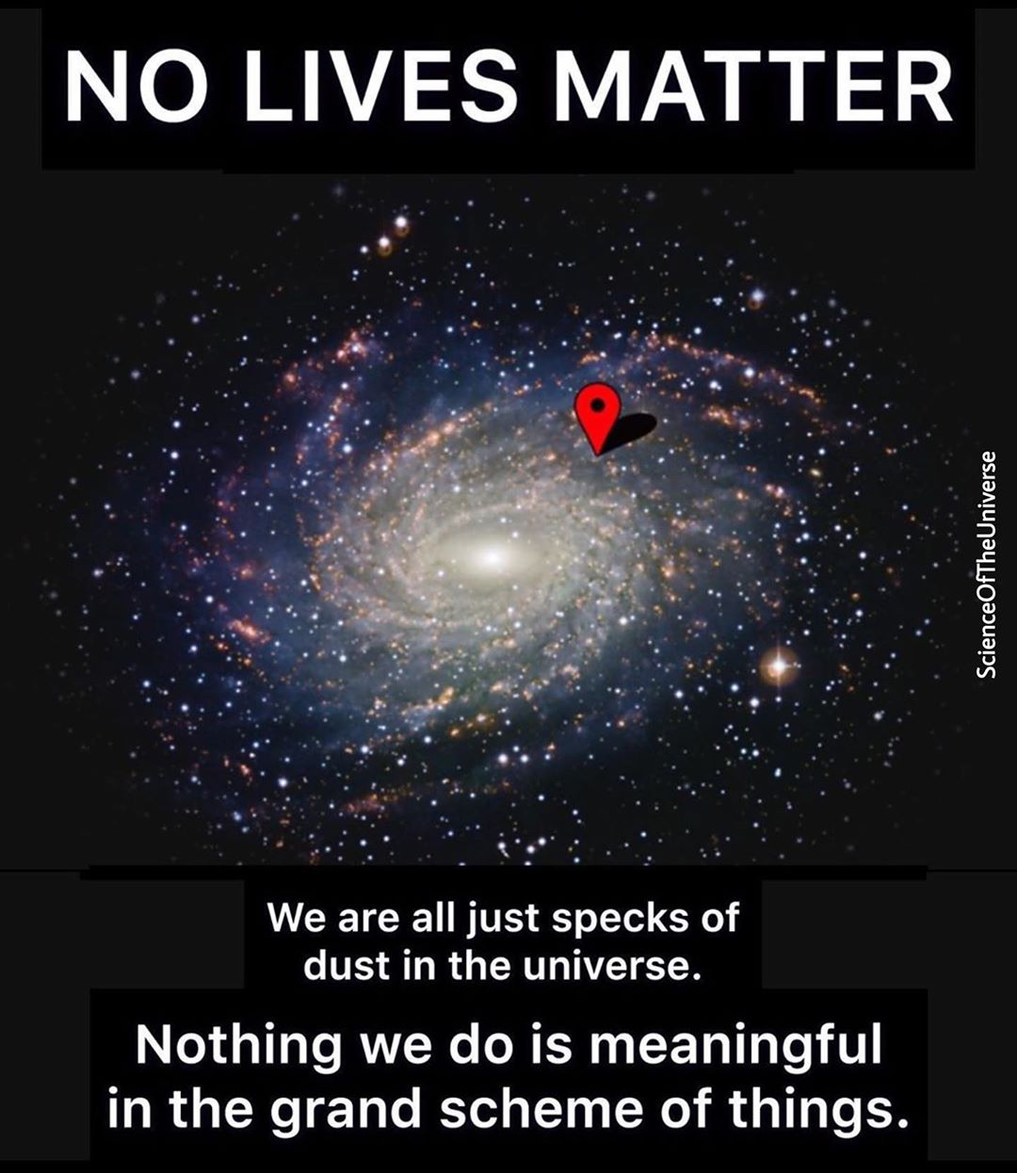

Slide 2

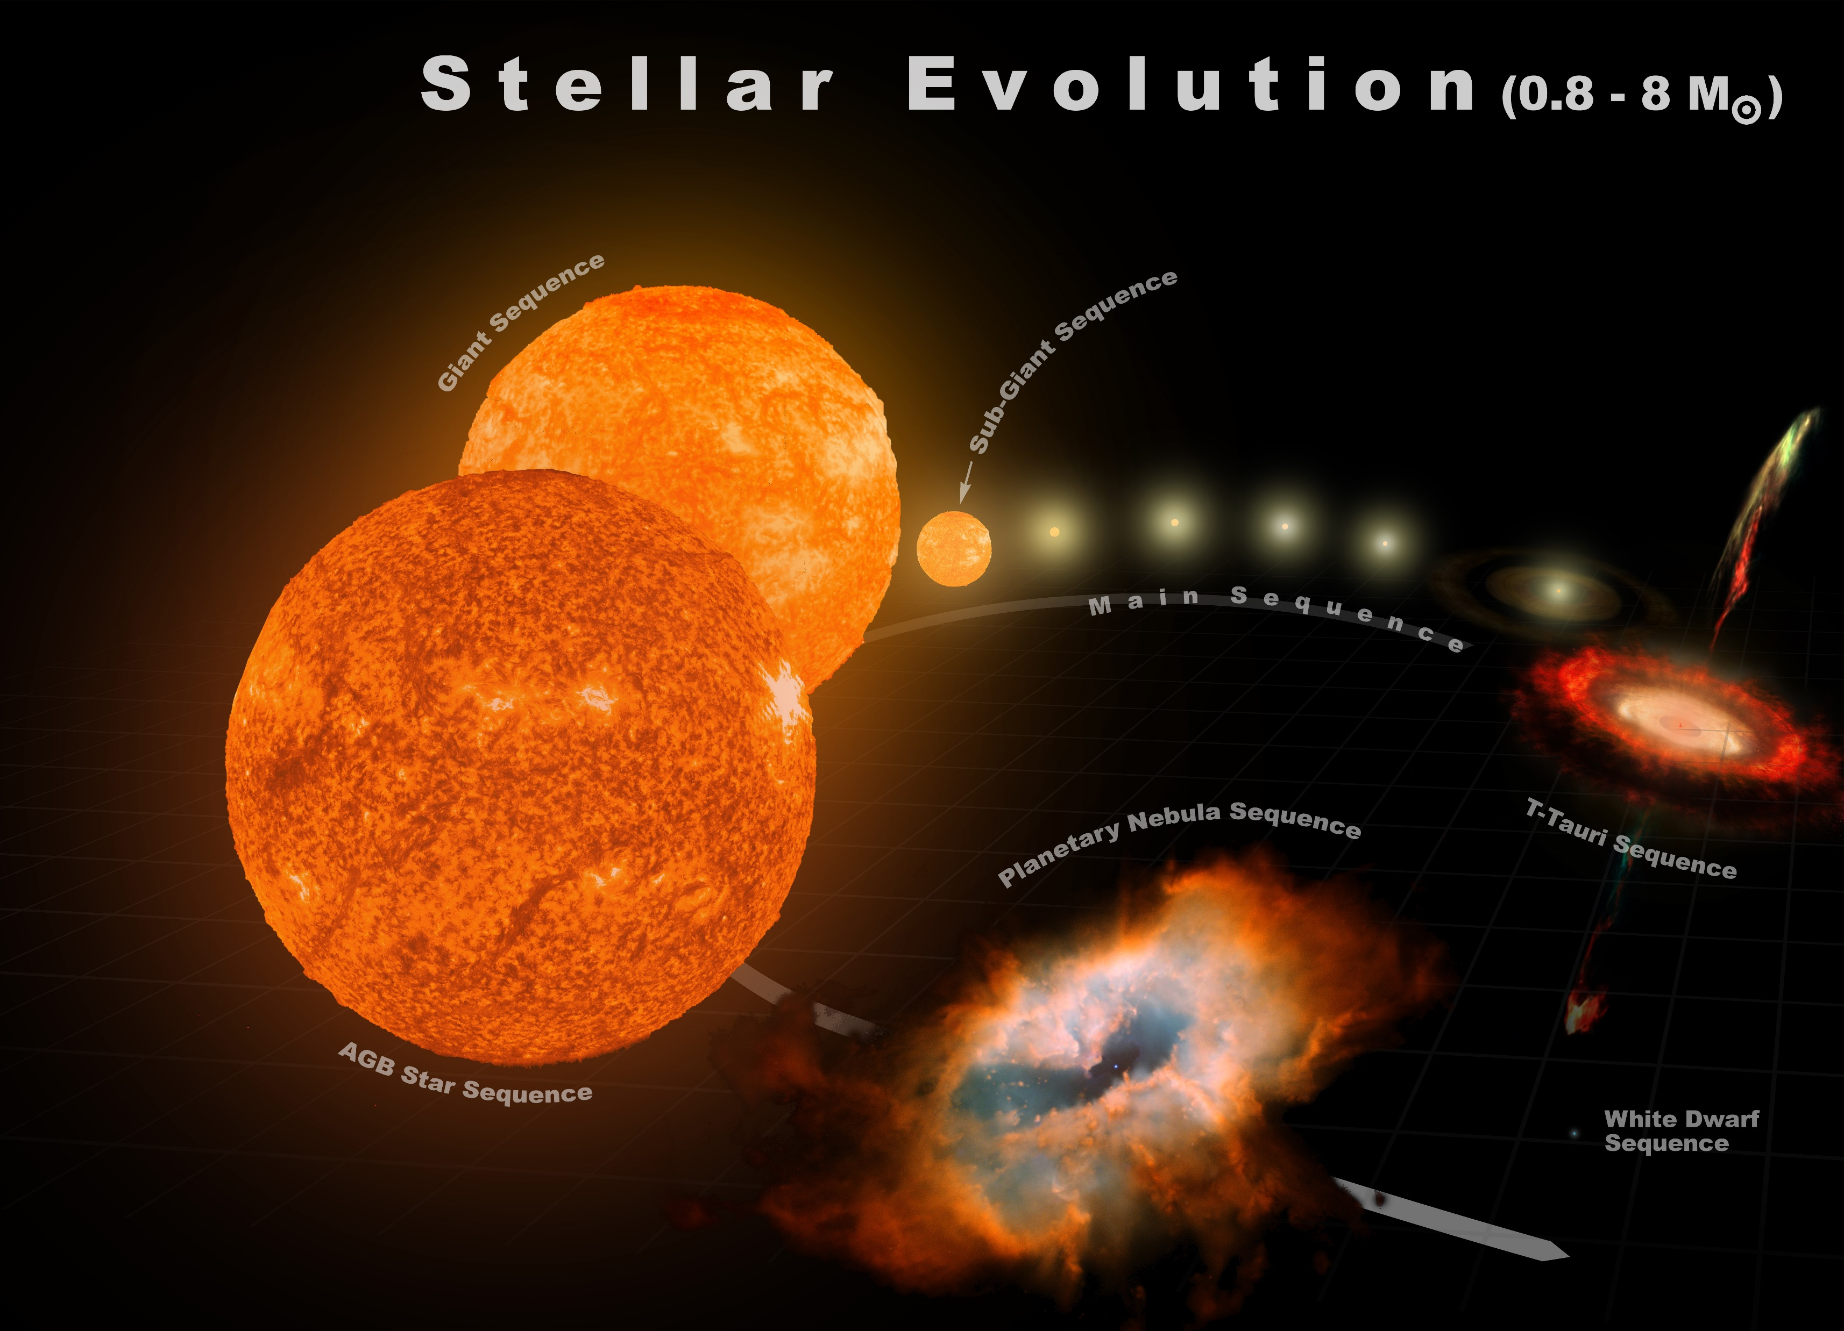

Slide 3
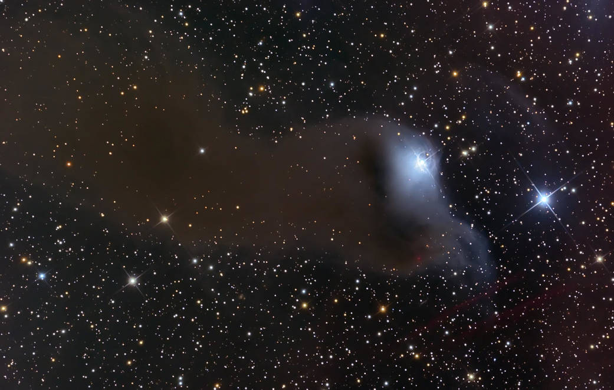
STAGE : 1

Slide 4
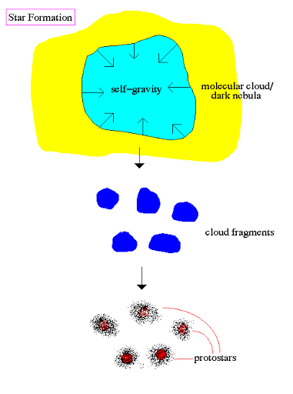
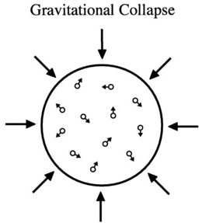

Slide 5
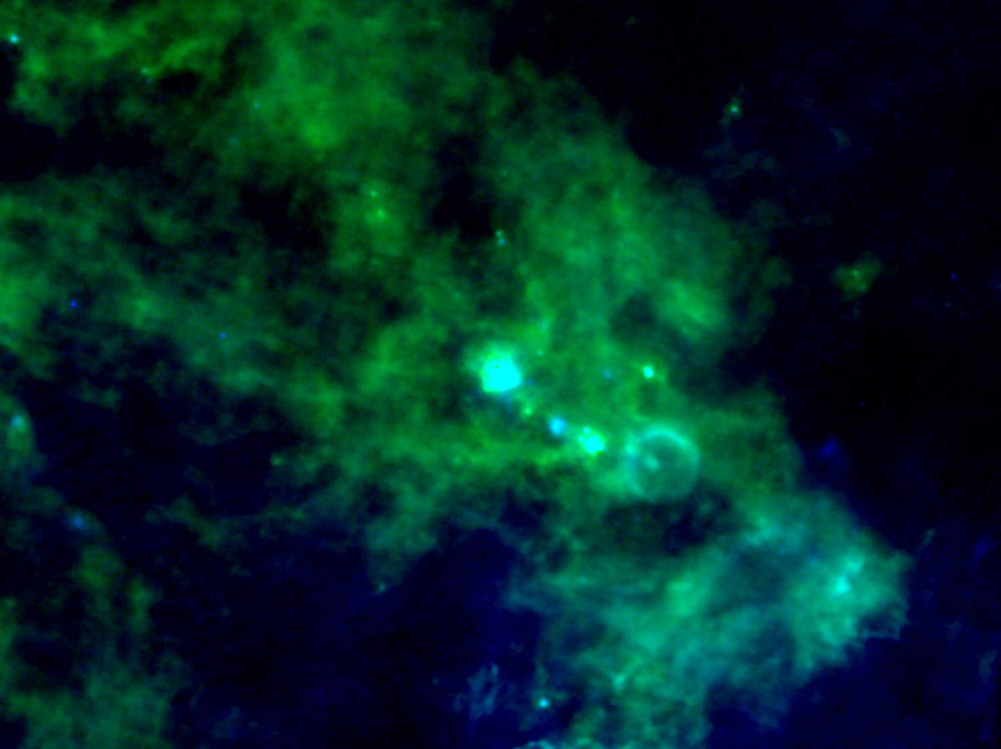
STAGE : 2 & 3
In the stage 2 and 3, the interstellar cloud start gaining shape like a sphere.
STAGE : 2
Temperature : 100 K
Particle density :
10¹² particles/m³.
STAGE : 3
Temperature : 10000 K
Particle density : 10¹⁸ particles/m³.
Protostar forming region

Slide 6
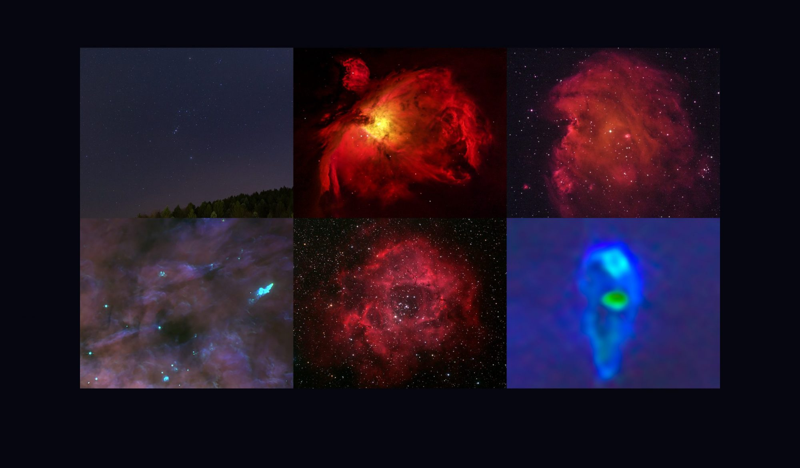
STAGE : 4
Temperature : 10⁶ K
Becklin-Neugebaur object
These photos in the Orion nebula, shows stage-4 of stellar evolution, having a luminosity 1000 times of our Sun.

Slide 7
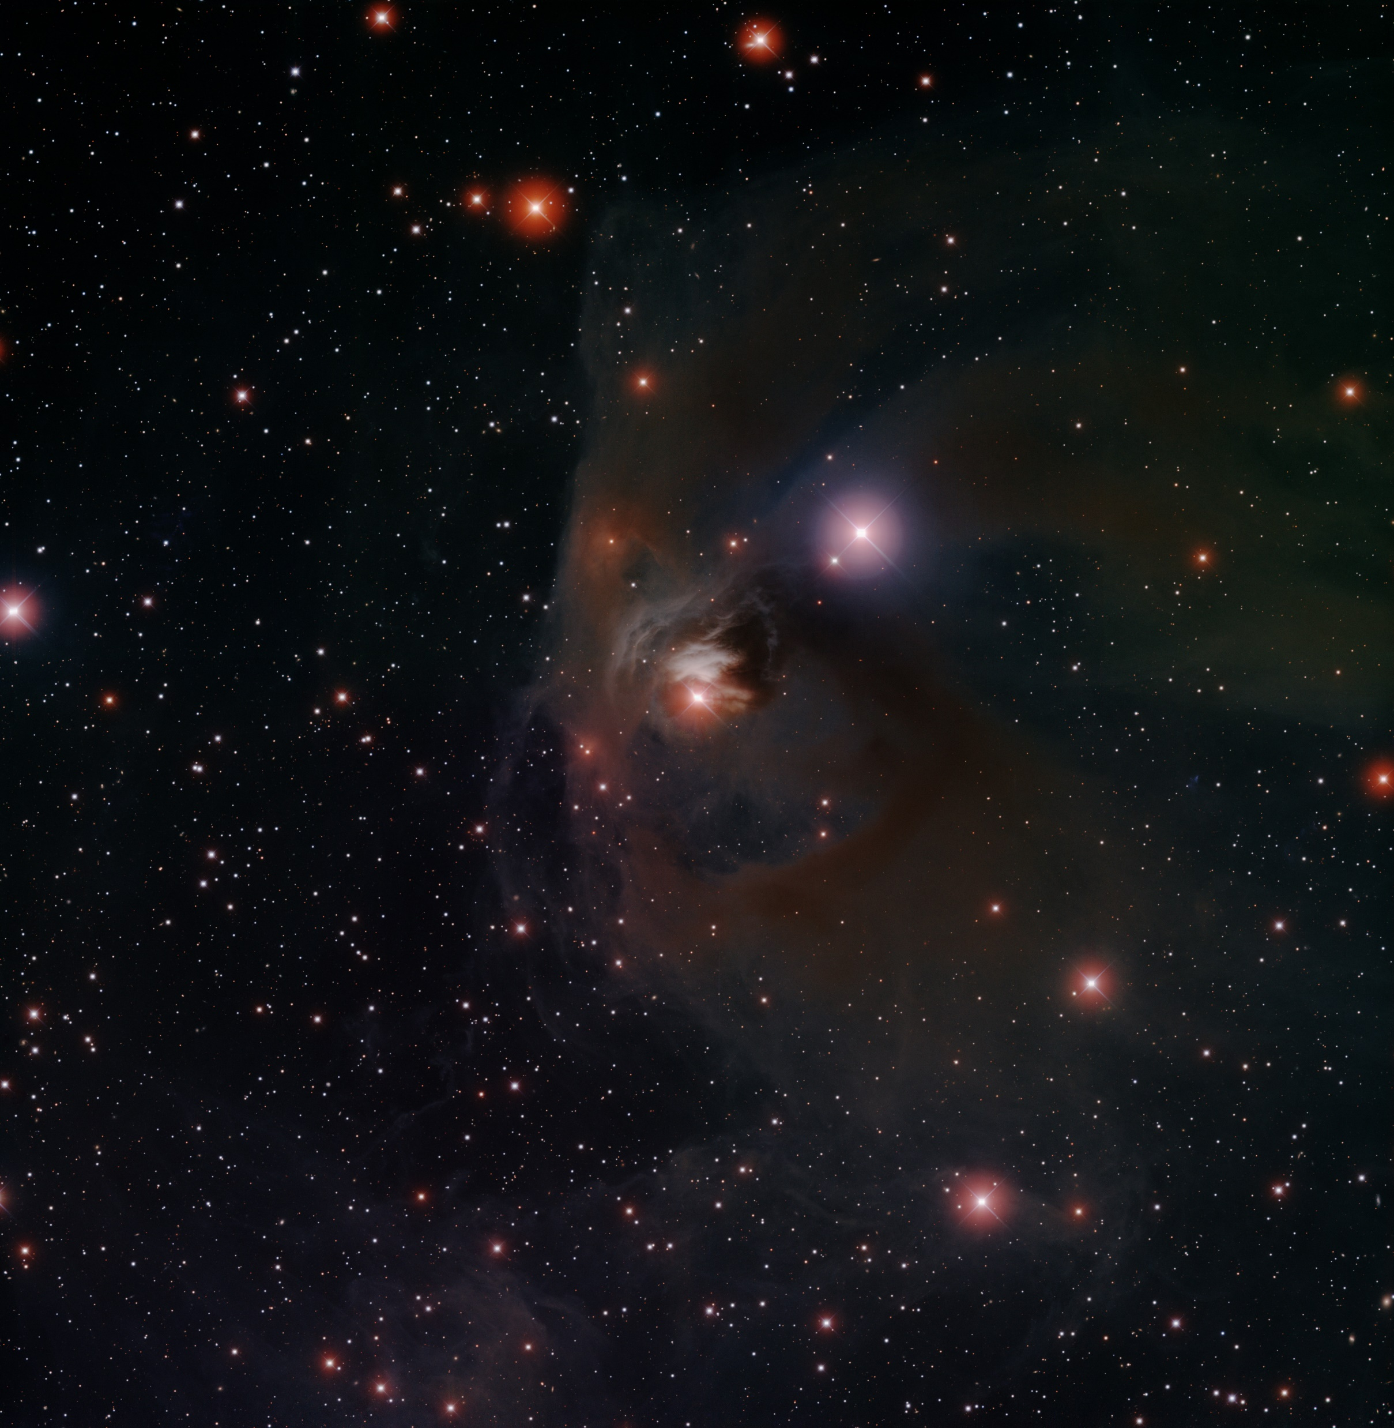
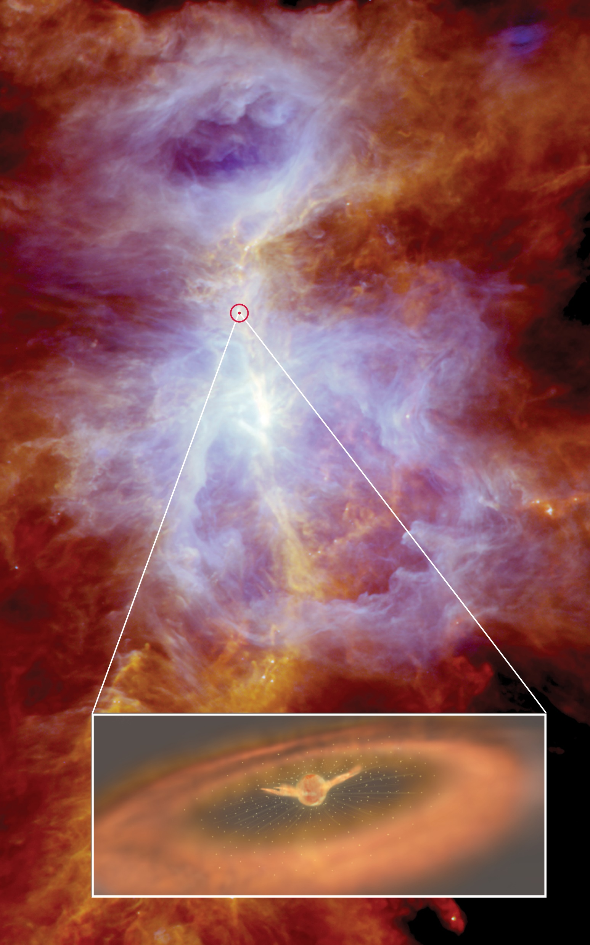
STAGE : 5
The star still isn’t in equillibrium
Protostellar wind in orion nebula

Slide 8
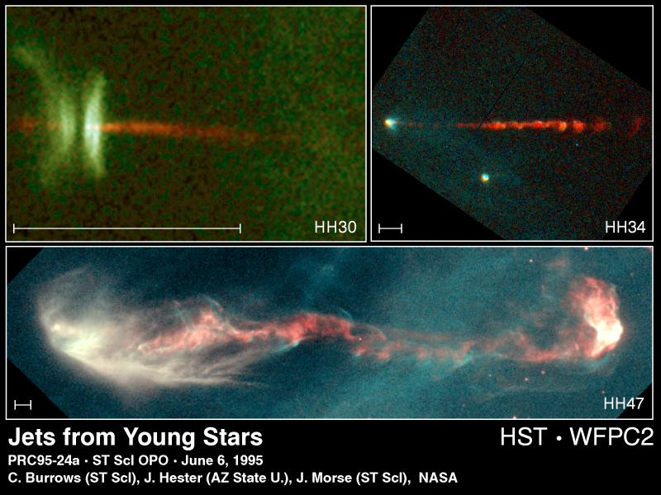
The strong protostellar wind interacting with the nebular disk, around the star, forms a bipolar flow; seems two jets of matter perpendicular to the nebular disk.

Slide 9
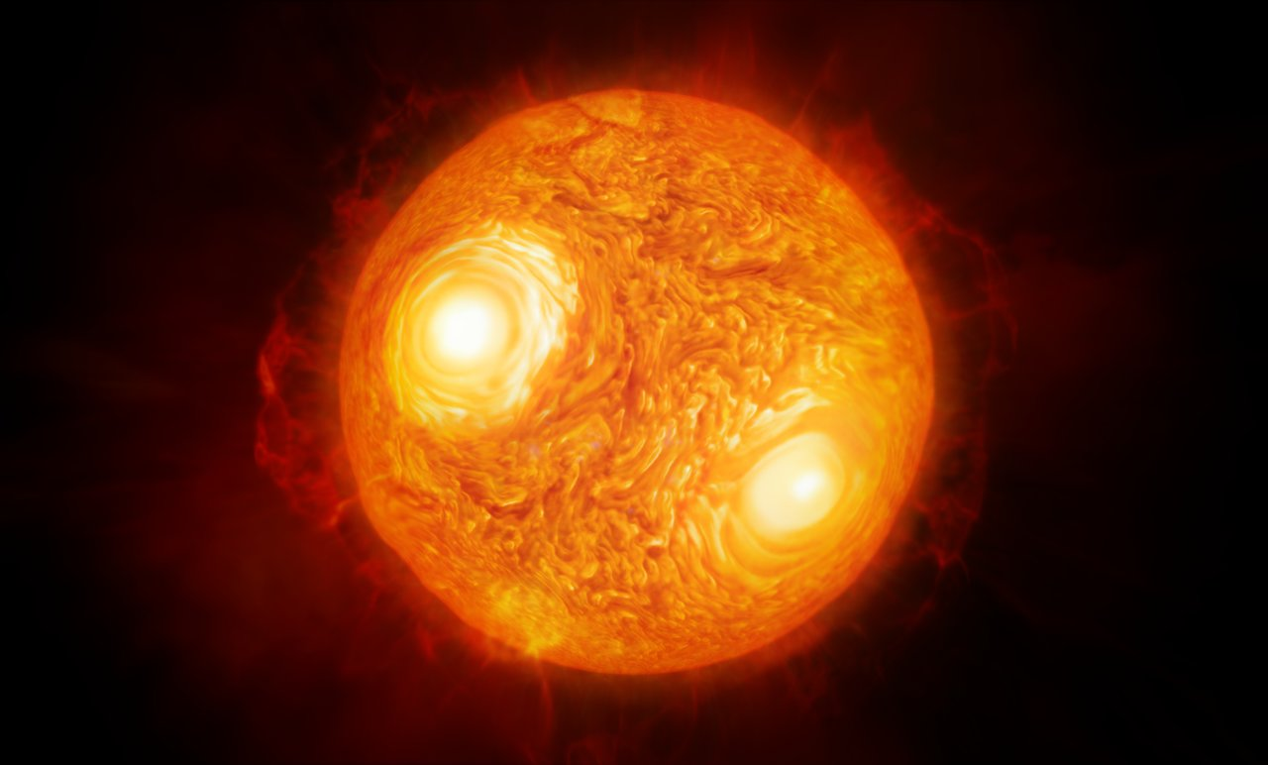
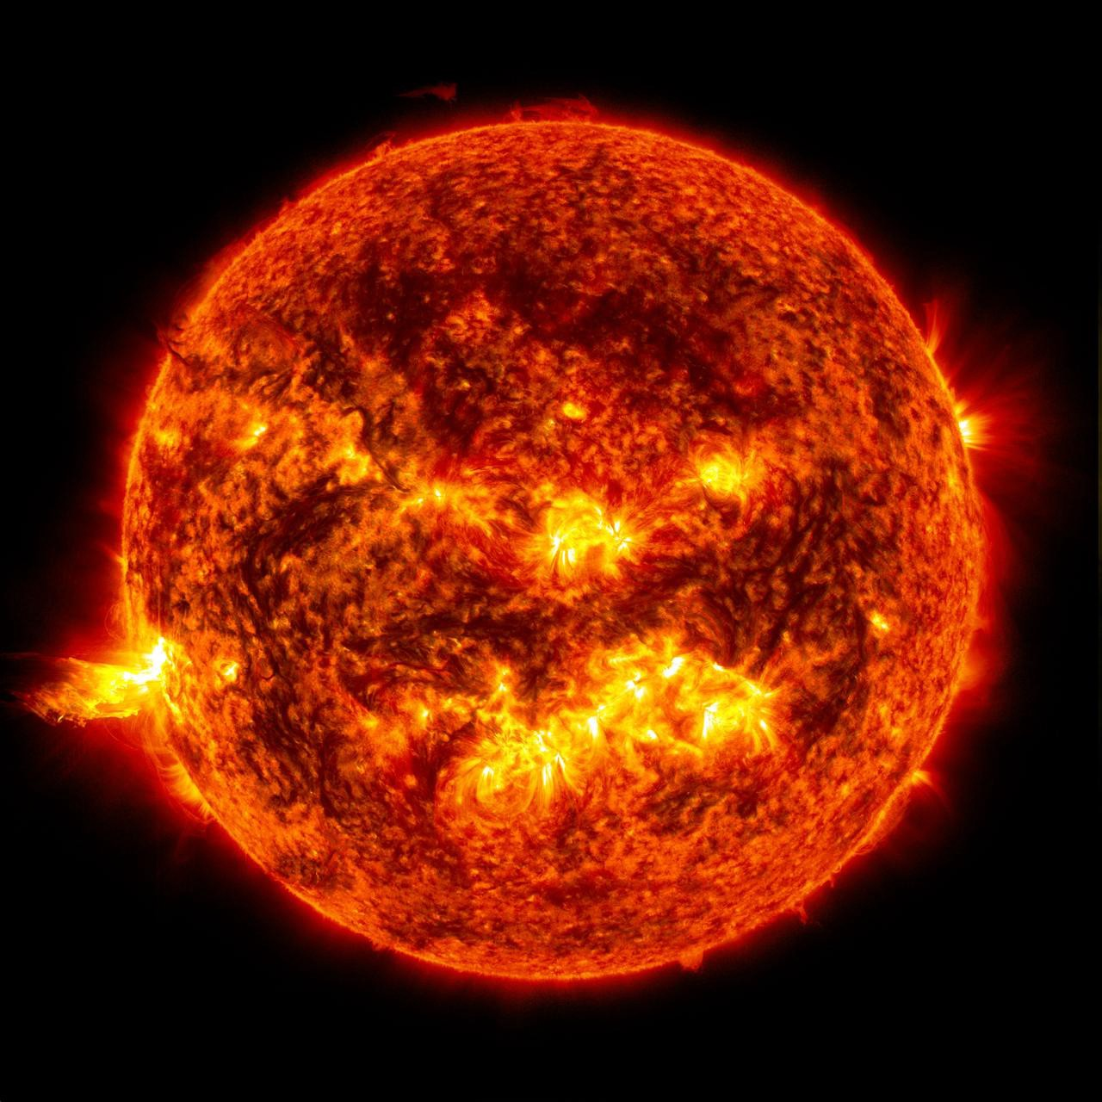
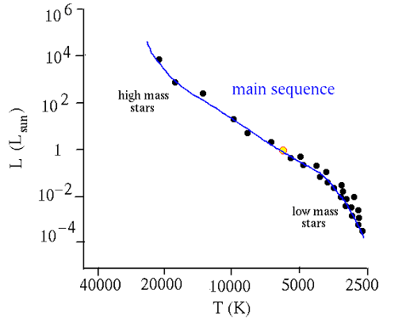
Stage : 6
Start taking spherical shape.
Core temperature : 10⁷K
Surface temperature : 4500 K
Stage : 7
The star is now an ideal one.
Core temperature : 1.5* 10⁷K
Surface temperature : 6000 K
Density : 10³² particles/m³

Slide 10

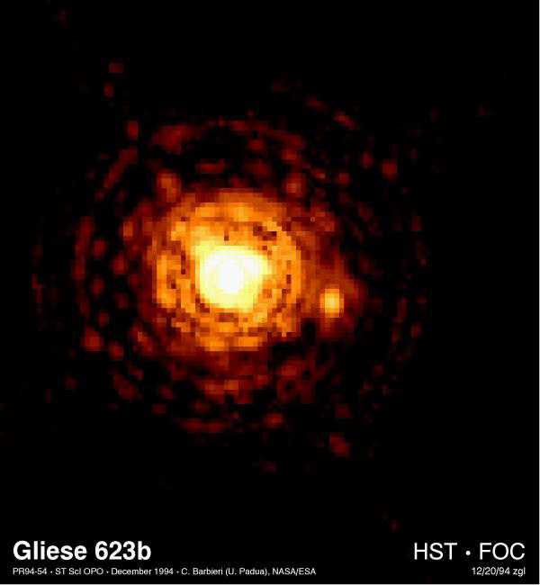
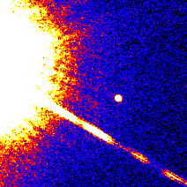
Brown Dwarf
Gliese 299 B system

Slide 11
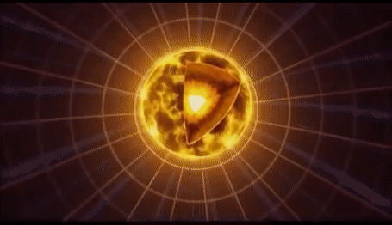
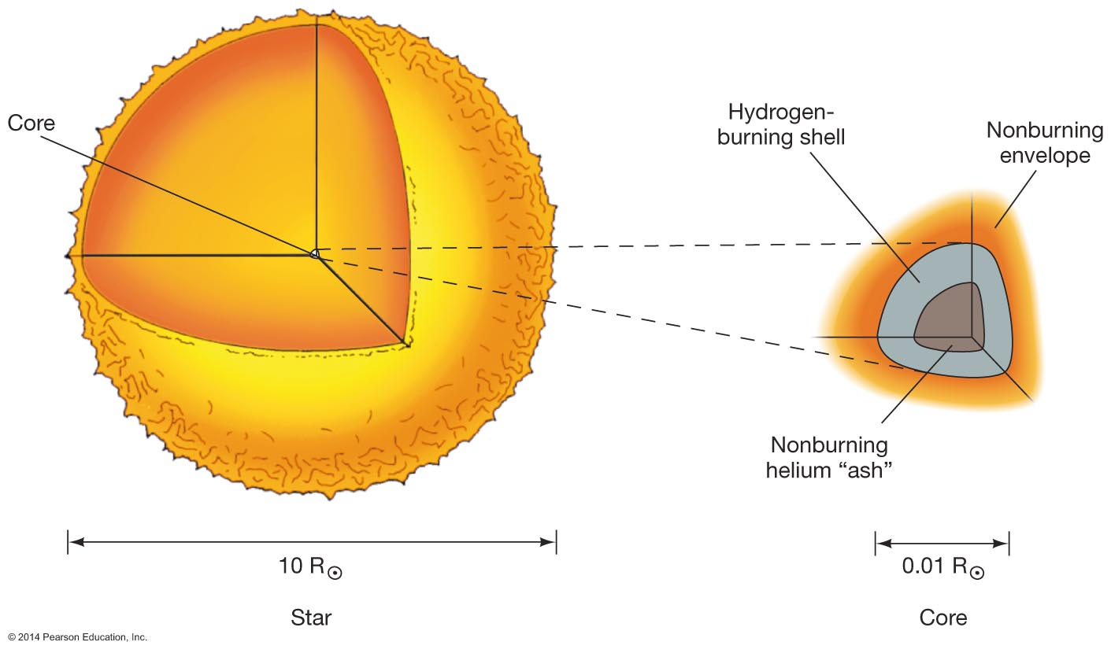
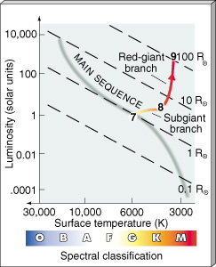
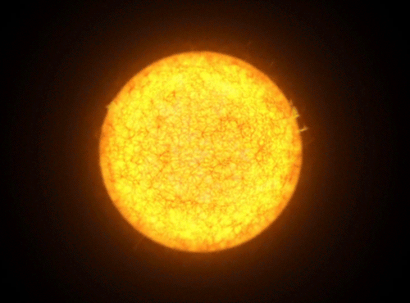
Stage
8 & 9

Slide 12
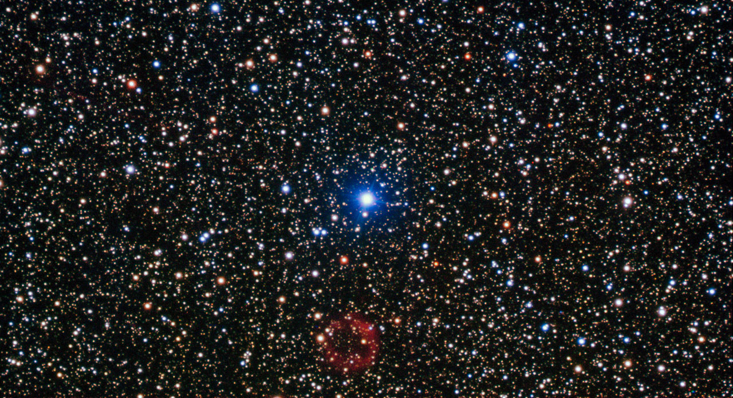
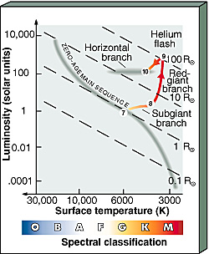
Stage : 10

Slide 13
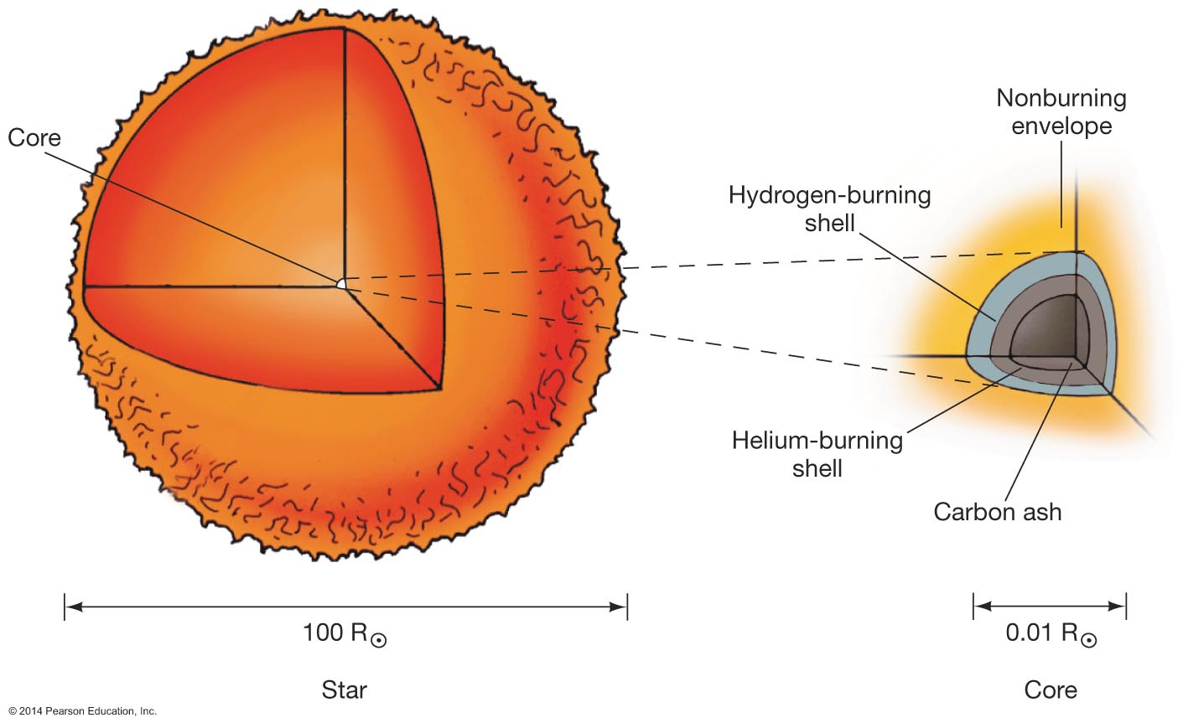
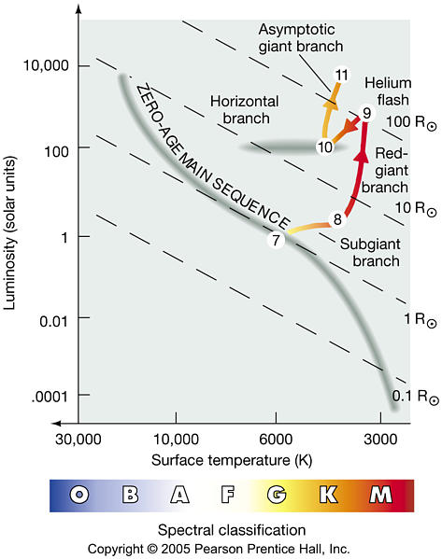
Stage : 11

Slide 14
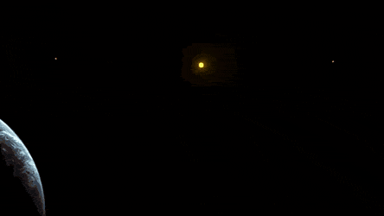

Slide 15
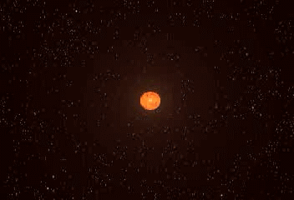
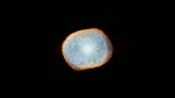
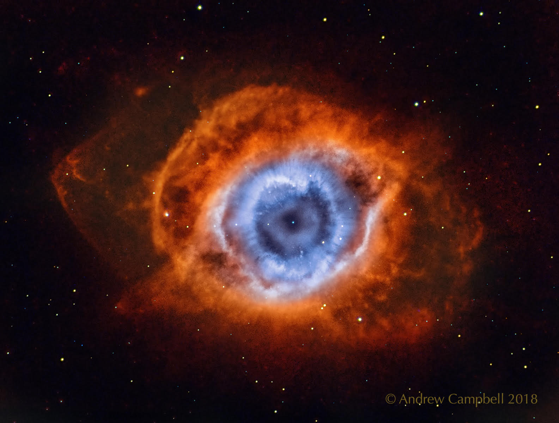
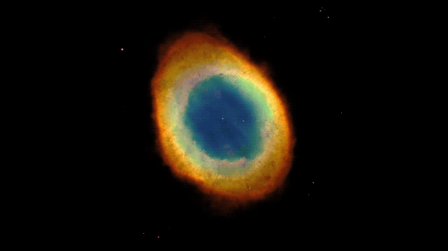
STAGE : 12
The God’s eye / Helix nebula

Slide 16
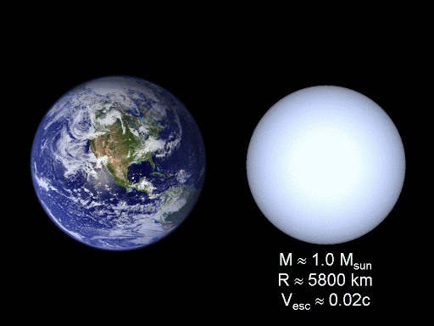
Pauli’s principle comes to play at the dense core of the formed core, which prevents the electron to crush on each other, after a certain distance between them.

Slide 17
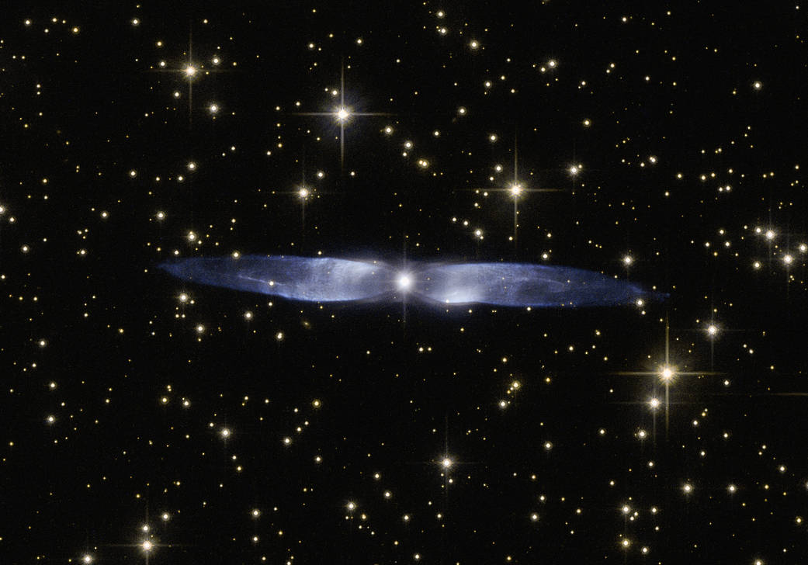
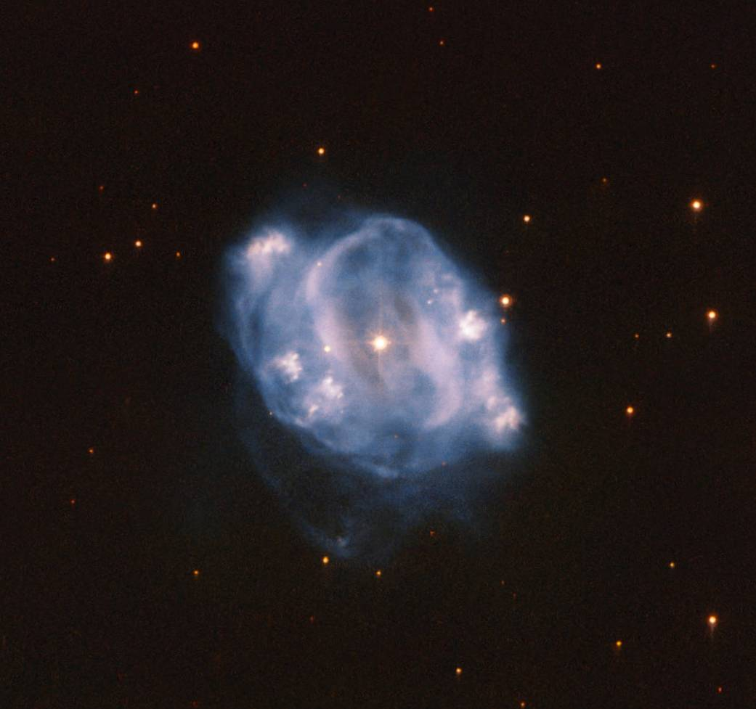
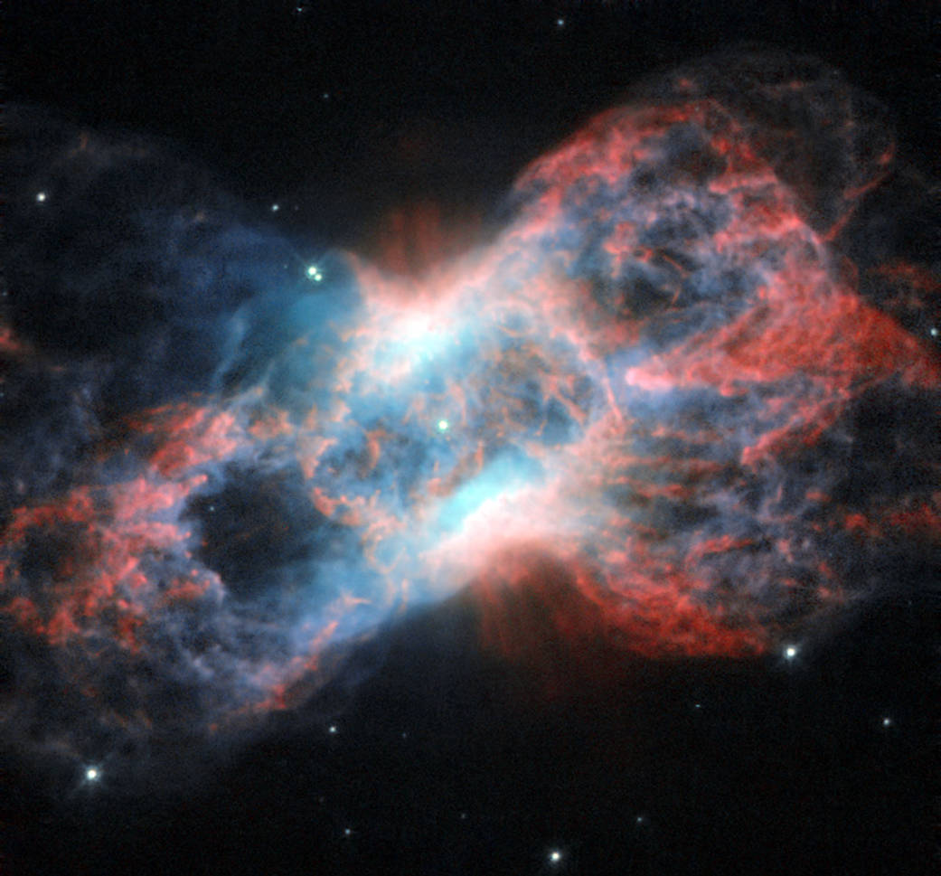
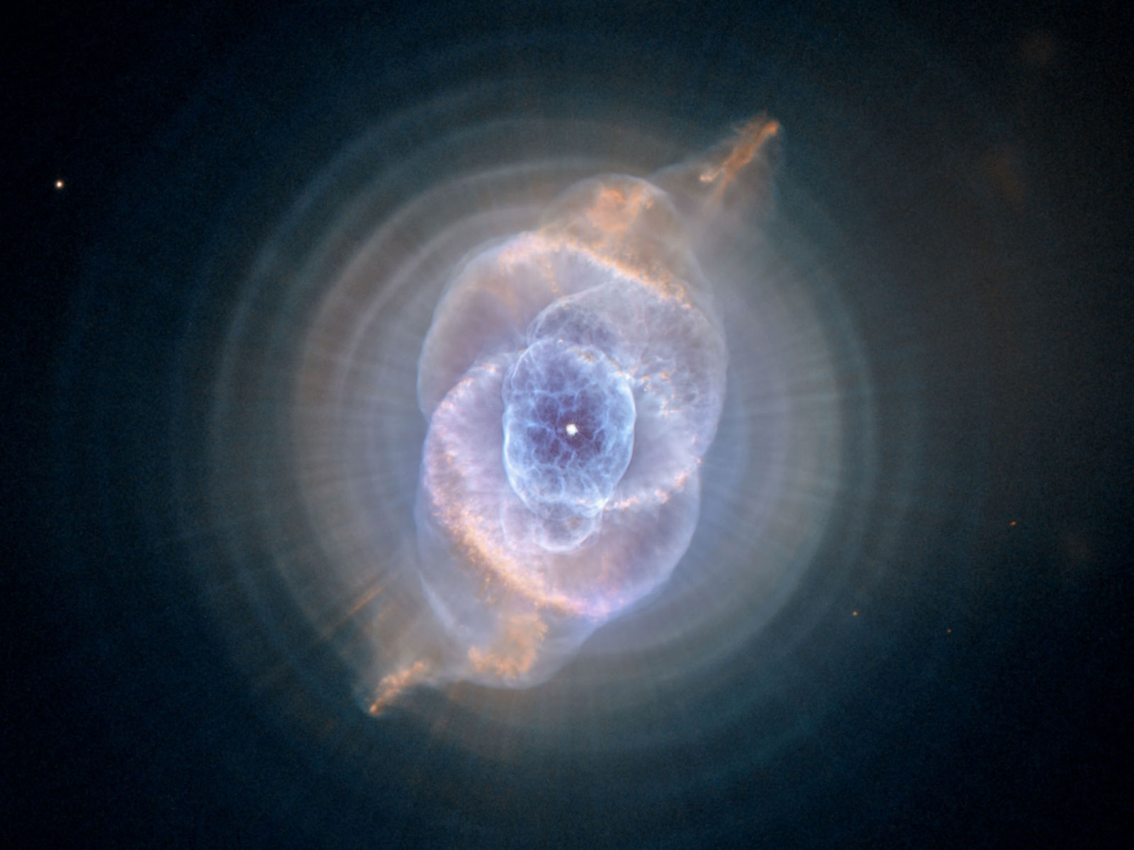
STAGE : 13 ( A white dwarf )
NGC 5307
Twin Jet nebula
Cat’s Eye nebula
NGC 7026

Slide 18

I am a Black dwarf.
I am a garbage.

Slide 19
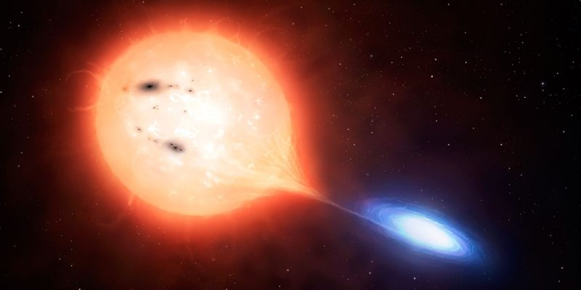
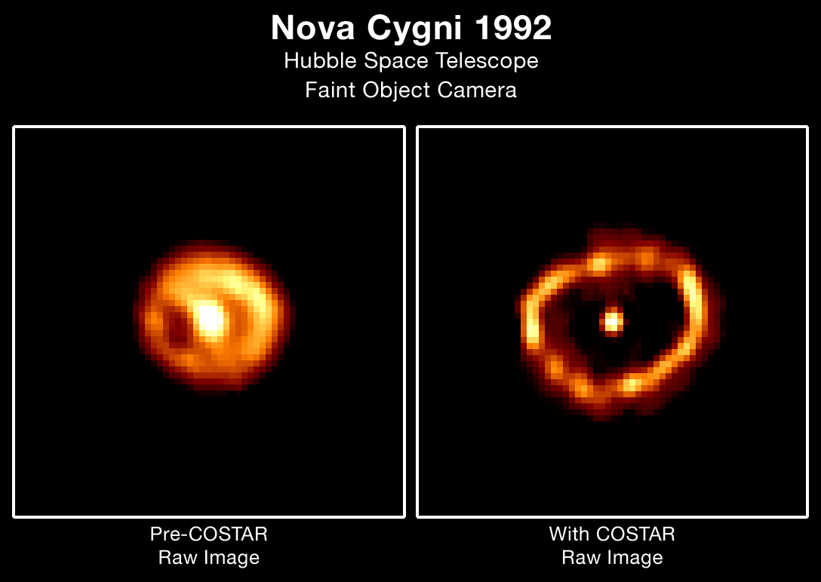
A rare event Nova , from White Dwarfs

Slide 20
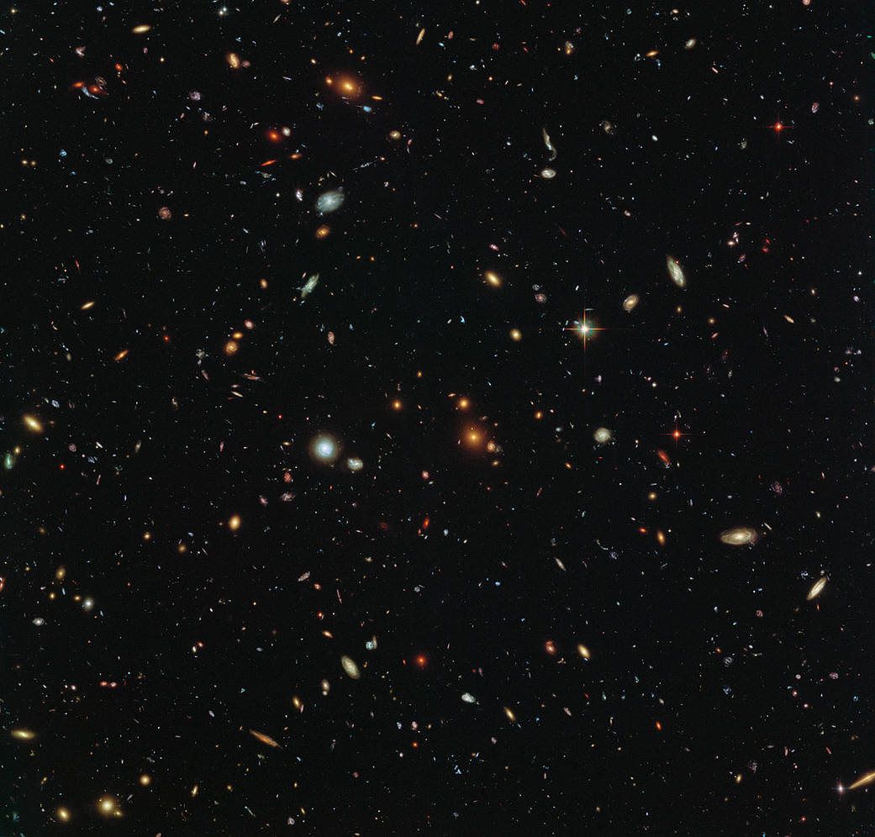
Thanks !

